Slide 1
Camden Wastewater
Wastewater Treatment Facility, Sewershed
Treatment Plant:
Overview of staffing levels and equipment
Regulatory Requirements (MEPDES permit)
General Responsibilities
Diagram of treatment plant process &Overview of improvements to treatment plant
Sewershed:
Explanation of a sewershed
Map of sewershed
Explanation of pumping stations and locations within the sewershed
Notes:
40 miles are town and 18 are state
15 trucks, 10 plow, loader, backhoe, excavator, 3 sidewalks machines
8 plow routes which take about 3 hours each to complete, sidewalks take between 4 and 8 hours depending on the storm

Slide 2
Wastewater Treatment Facility
The treatment plant was built in 1970
The treatment plant is licensed for 1.21 MGD on a monthly average
The facility is located at 20 lions lane and is 5.1 acres in size
Average flow over the past 12 months was 1.063 MGD
Average low flow over the past 12 months was .661 MGD
The flow during the past weekend’s .6 inches of rain was .527 on Friday and .705 on Saturday
On April 30, 2023 with 4’’ of rain, the plant received 3.07 MGD with a peak flow of 6.19
The facility has 5 employees
Facility operations director (grade 3 wastewater license)
Two plant operators ( both have a grade 3 waste wastewater license)
One treatment plant mechanic ( also has a grade 3 wastewater license)
One centrifuge/assistant mechanic

Slide 3
Wastewater Treatment Facility
Equipment at the facility consists of:
An equipped laboratory with various testing equipment
Camera van used for televising and recording sewer/stormwater lines
Jet truck and root cutter
Portable generator
4-wheel drive tractor
Fork truck
¾ ton pick-up with lift gate
1 ton dump truck
Ford transit van
½ pick-up

Slide 4
Wastewater Treatment Facility
General day to day responsibilities:
Perform daily laboratory sampling and testing
Daily plant process checklist
Inspect daily the two main pump statons and perform preventative maintenance. Once per week each pump staton is inspected and the pumps are evaluated for operation and run time.
Preventative maintenance on plant process equipment
Collection system jetting
Collection system camera work
Flow meter installation and monitoring
Dig safe requests
Additional sampling and testing for PFAS

Slide 5
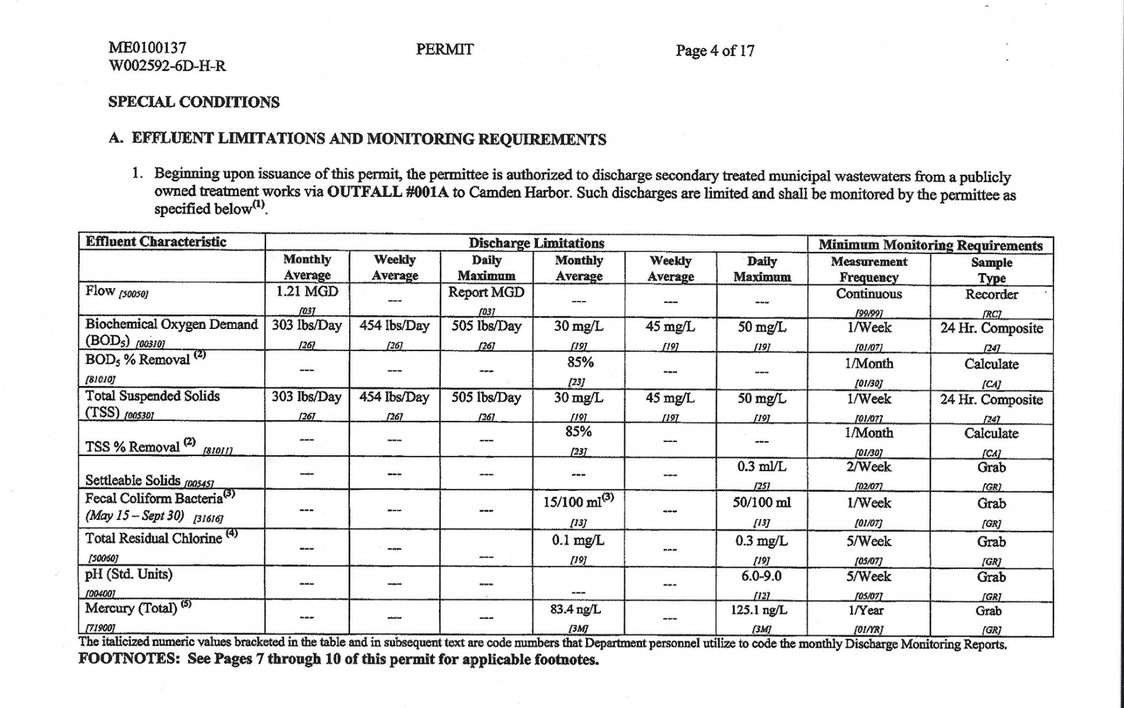
Camden Wastewater
Permit & Regulator Requirements
Notes:
40 miles are town and 18 are state
15 trucks, 10 plow, loader, backhoe, excavator, 3 sidewalks machines
8 plow routes which take about 3 hours each to complete, sidewalks take between 4 and 8 hours depending on the storm

Slide 6
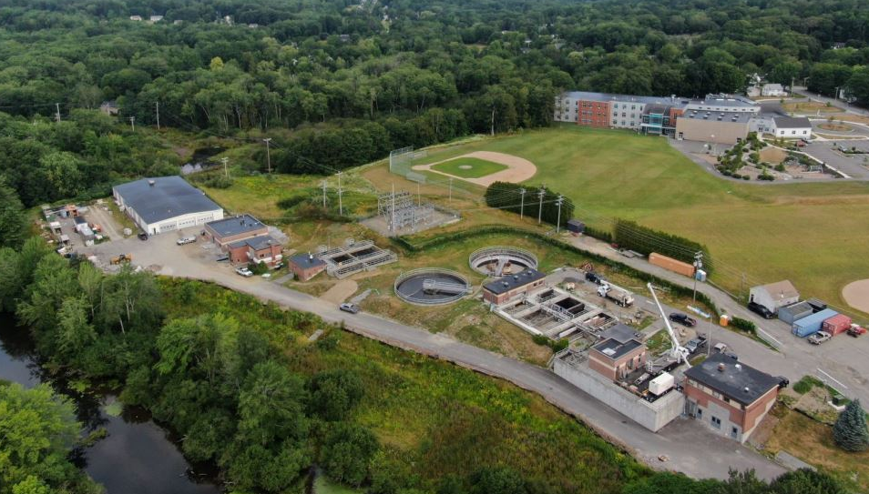
Wastewater Treatment Facility
Treatment Train Process Flow
Approximately 975 tons of sludge cake a “special waste” is sent to Juniper Ridge. Frequency is 1 time per week at about 12 to 15 tons per load
From Bay View and Rawson Ave pump stations
Treated wastewater then is disinfected then goes to Harbor

Slide 7
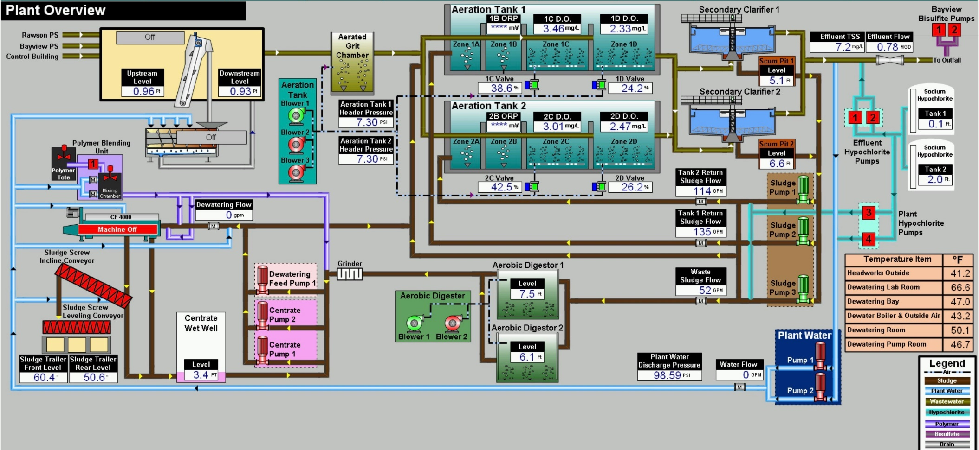
Wastewater Treatment Facility
New SCADA intergraded into plant operations

Slide 8
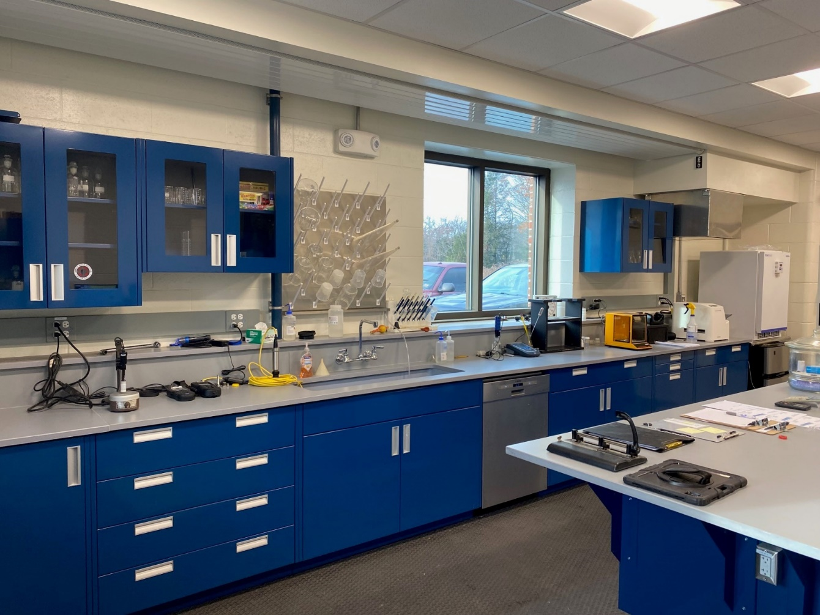
Wastewater Treatment Facility
New Upgraded Laboratory
Notes:
40 miles are town and 18 are state
15 trucks, 10 plow, loader, backhoe, excavator, 3 sidewalks machines
8 plow routes which take about 3 hours each to complete, sidewalks take between 4 and 8 hours depending on the storm

Slide 9
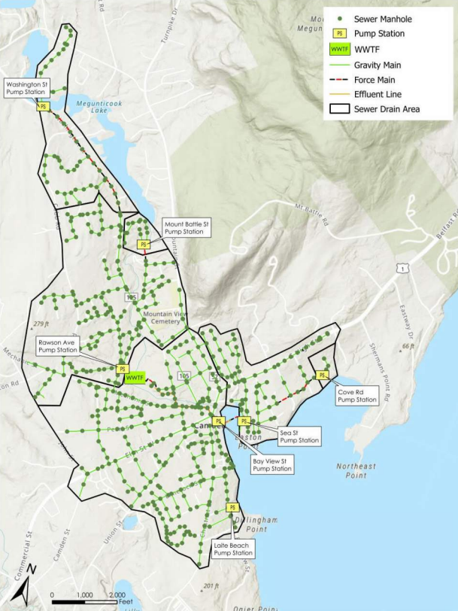
Wastewater Collection System
Collection System Inventory
25 miles of gravity sewer
2 miles of force main
560+ sewer manholes
7 pump stations
Notes:
40 miles are town and 18 are state
15 trucks, 10 plow, loader, backhoe, excavator, 3 sidewalks machines
8 plow routes which take about 3 hours each to complete, sidewalks take between 4 and 8 hours depending on the storm

Slide 10
Wastewater Sewershed
(7) Pump stations
Bay View Pump station
Upgraded 2004, 2008, 2023
Sea Street Pump Station
Upgraded 2015
Cove Road Pump Station
Upgraded 2023
Laite beach Pump Station
Upgraded 2018
Rawson Avenue Pump Station
Upgraded 2011
Washington Street Pump Station
Upgraded 2023
Mount Battie Pump Station
Upgraded 2015
Notes:
The area of land where all the sewers flow to a single end point

Slide 11
Camden Wastewater
Capital Improvements Overview
Capital Improvements:
I & I = Inflow & Infiltration
Exfiltration
Pearl & Free Streets overview & lessons learned
Notes:
40 miles are town and 18 are state
15 trucks, 10 plow, loader, backhoe, excavator, 3 sidewalks machines
8 plow routes which take about 3 hours each to complete, sidewalks take between 4 and 8 hours depending on the storm

Slide 12
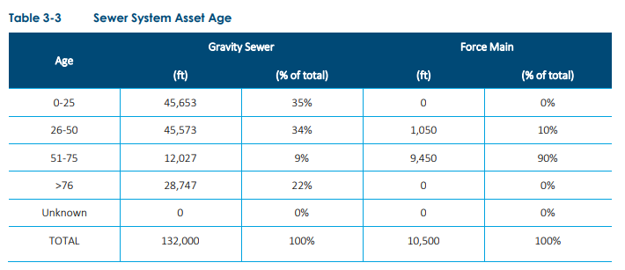
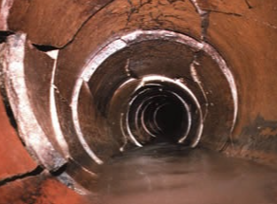
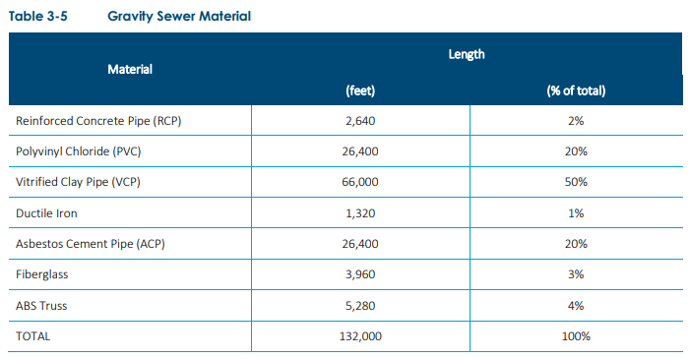
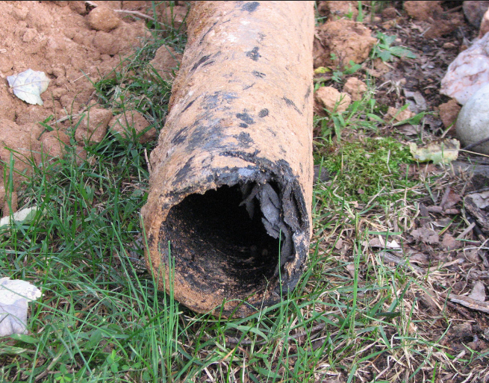
Wastewater Collection System
Notes:
50 to 80 years is the average life of clay pipe. The leakage exfiltration or infiltration shall not exceed 100 gallons per inch of pipe diameter per mile per day
31% of our gravity sewer is between 51 – 76 years old, 31% is between 26 – 50 years old

Slide 13
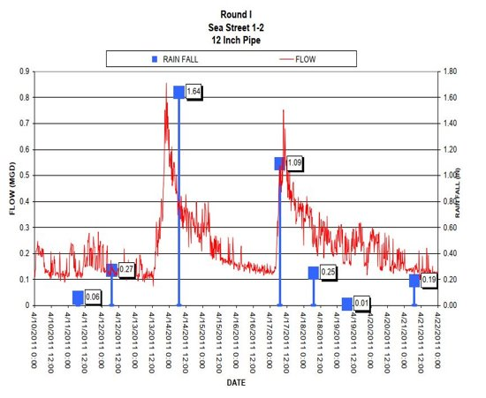
Wastewater Collection System
What is Inflow & Infiltration?
Infiltration:
Infiltration is groundwater entering the sewer system through leaking pipes and manholes
Typically, highest in the spring when groundwater levels are the highest
Inflow:
Inflow is stormwater entering the sewer system through direct connections such as catch basins, roof drains, sump pumps, and foundation drains
Flow in sewers increase very quickly during rain events through Inflow sources
Notes:
50 to 80 years is the average life of clay pipe. The leakage exfiltration or infiltration shall not exceed 100 gallons per inch of pipe diameter per mile per day

Slide 14
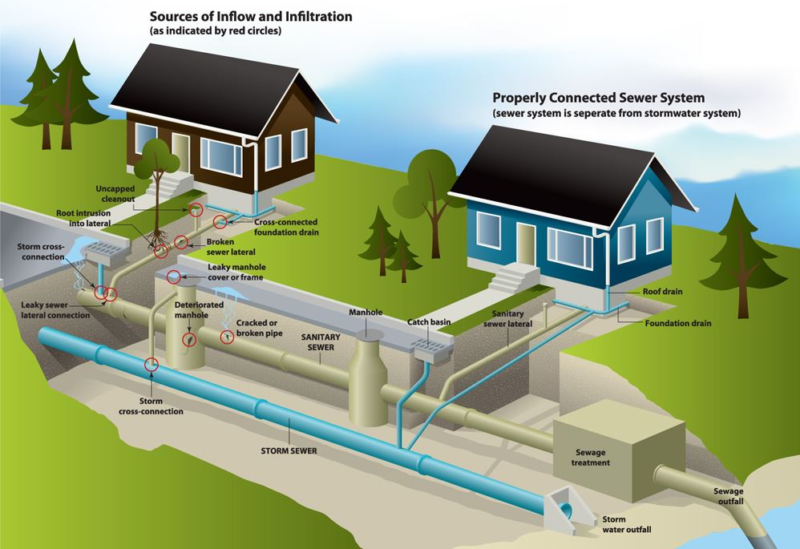
Wastewater Collection System
What is Inflow & Infiltration?
Notes:
50 to 80 years is the average life of clay pipe. The leakage exfiltration or infiltration shall not exceed 100 gallons per inch of pipe diameter per mile per day

Slide 15
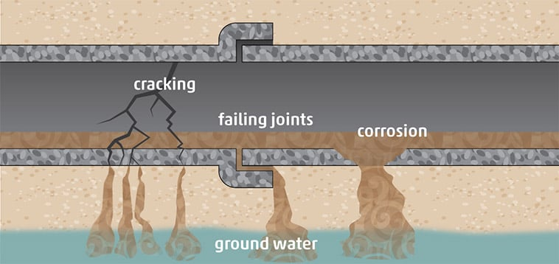
Wastewater Collection System
What is Exfiltration?
Notes:
Exfiltration is defined as the leakage of wastewater out of a sanitary sewer system. Exfiltration seeps out of broken or damaged pipes and manholes

Slide 16
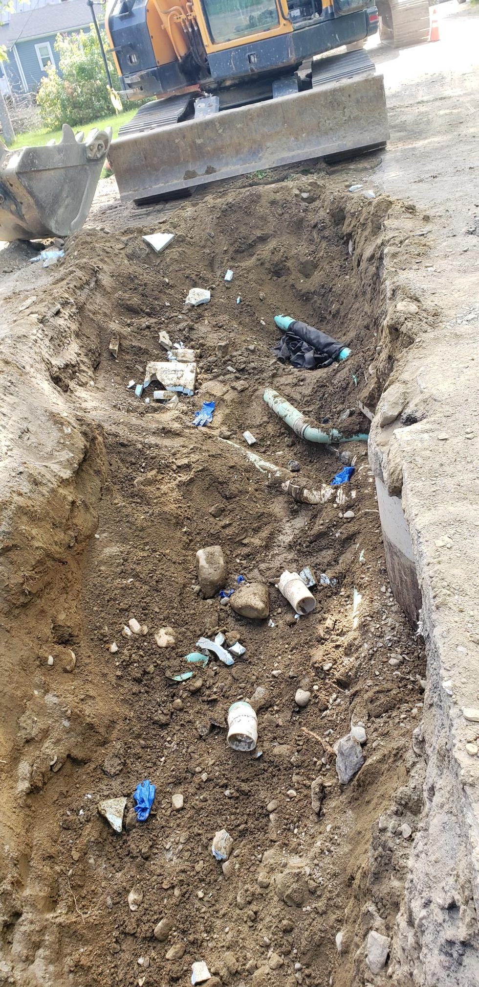
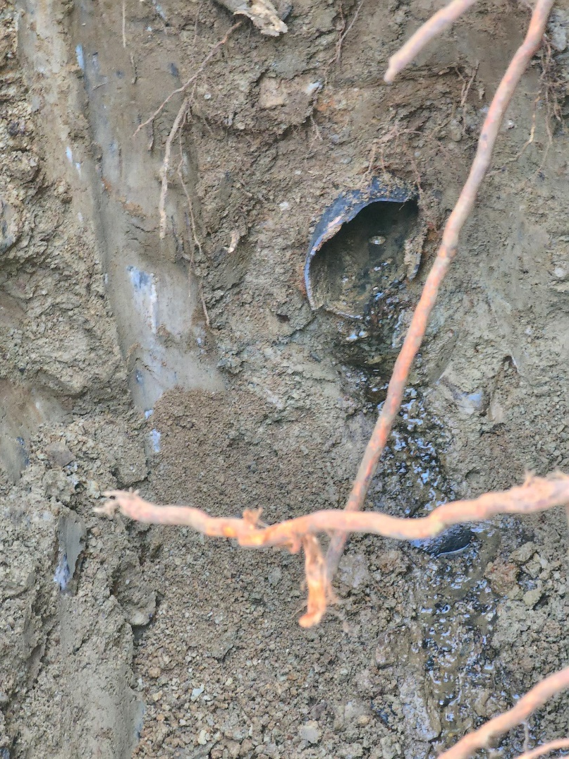
Wastewater Collection System
Orangeburg laterals
Patched laterals
* Inspections are critical! **Master Drainlayer Certification this winter
Notes:
40 miles are town and 18 are state
15 trucks, 10 plow, loader, backhoe, excavator, 3 sidewalks machines
8 plow routes which take about 3 hours each to complete, sidewalks take between 4 and 8 hours depending on the storm

Slide 17
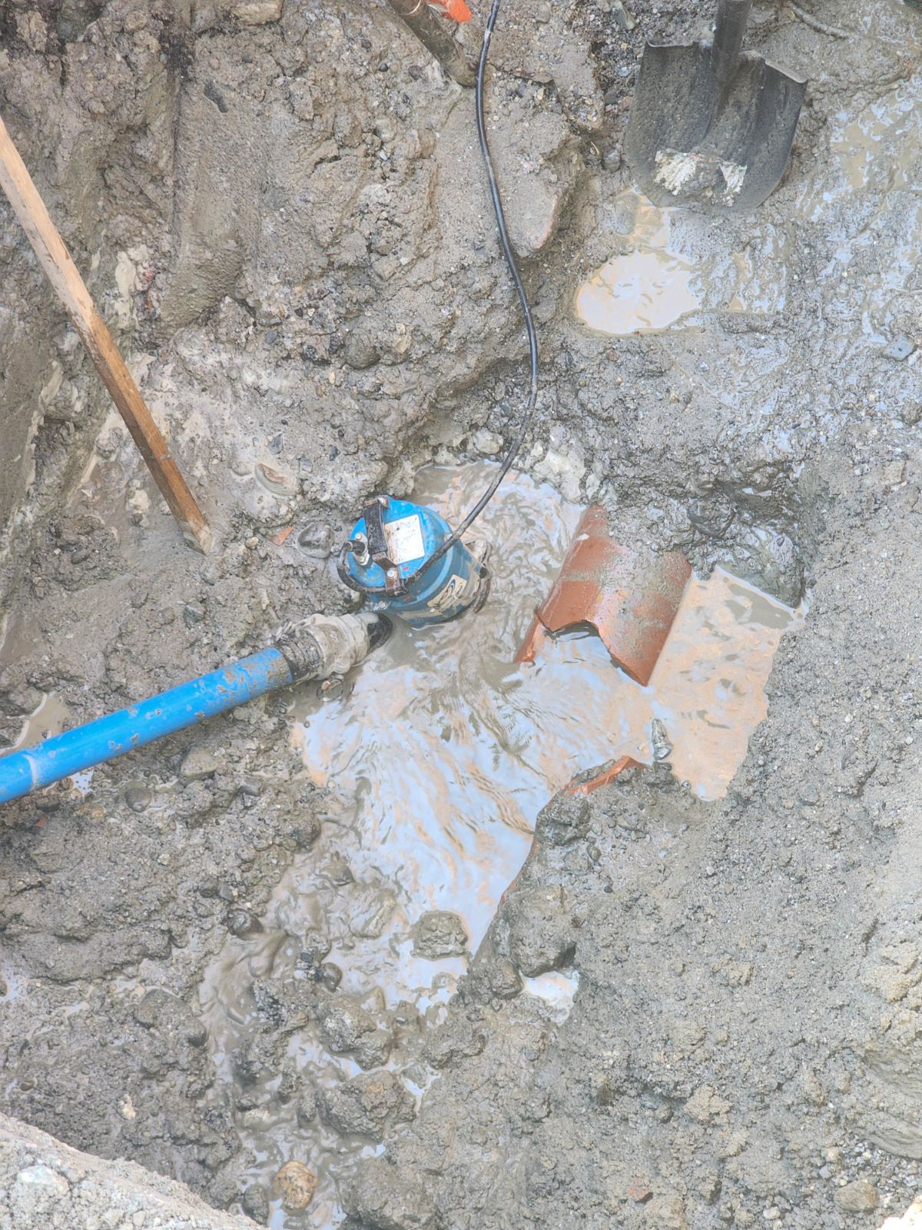
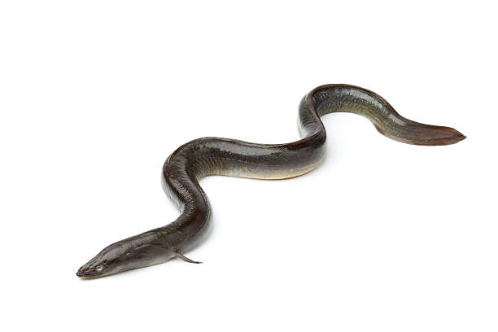
Wastewater Collection System
Example of ground water that was getting into an old section of sewer
A nine-inch eel was found in one of the old clay sewer and we think it probably came from the cross-country line going thru the bog.
Notes:
40 miles are town and 18 are state
15 trucks, 10 plow, loader, backhoe, excavator, 3 sidewalks machines
8 plow routes which take about 3 hours each to complete, sidewalks take between 4 and 8 hours depending on the storm

Slide 18
Wastewater Collection System
Every Lateral Was Video Camera Inspected
Pearl & Free Street overview
Three old catch basins were tied into the old sewer line.
12 plus homes were actively tied into sewer with foundation drains.
Vast amounts of ground water were infiltrating the system, due to the old pipe. According to town records, some portions of the line were installed in the early 1900’s.
Eliminated old, discontinued service lines, that were allowing ground water to enter existing sewer lines.
Over 85 plus new sewer service have been upgraded along with future use service lines. Eliminating the disruption of the rebuilt road, in the event of future development.
Notes:
40 miles are town and 18 are state
15 trucks, 10 plow, loader, backhoe, excavator, 3 sidewalks machines
8 plow routes which take about 3 hours each to complete, sidewalks take between 4 and 8 hours depending on the storm

Slide 19
Wastewater Collection System
Estimated Costs to fix piping between 26-75 years old
Units | Sewer | Road/Storm | Age | LF | Sewer | Road | Totals
Pearl | $ 1,500,000.00 | $ 428,629.00
linear ft | 7920 | 4000 | 51-75 | 12,027 | $ 2,733,409.09 | $ 1,546,536.29 | $ 4,279,945.39
 | $ 189.39 | $ 107.16 | 26-50 | 45,573 | $ 10,357,500.00 | $ 5,860,172.83 | $ 16,217,672.83
20% | $ 227.27 | $ 128.59 |  |  |  |  | $ 20,497,618.21
Notes:
40 miles are town and 18 are state
15 trucks, 10 plow, loader, backhoe, excavator, 3 sidewalks machines
8 plow routes which take about 3 hours each to complete, sidewalks take between 4 and 8 hours depending on the storm

